Slide 1
The Victorian Period 1832-1901

Slide 2
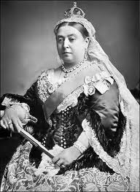
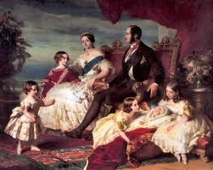
Queen Victoria
Reigned from 1837-1901

Slide 3
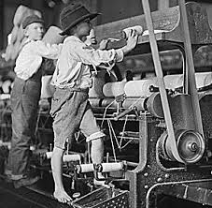
The industrial revolution
Benefits for the Middle Class
New towns
New goods
New wealth
New jobs

Slide 4
“The hungry forties”
On the whole, the Victorian era was characterized by economic depression. On an average, there were 1.5 million unemployed workers and their families on poverty relief.

Slide 5
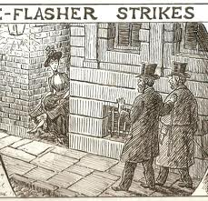
Victorianism = prudery
Prudery - the behavior or thinking of people who are too easily shocked or offended
Leg = limb; Improper to say “leg”
“Fallen” woman – one who has been seduced or was adulterous

Slide 6
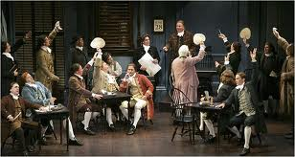
The Victorian theater
Marked by:
Prudery
Good taste
Repression of feelings
High-mindedness
Official censorship

Slide 7
The highest purpose of the poet:
To make readers aware of the connection between:
Earth and heaven
Body and soul
Material and ideal

Slide 8
Victorian themes
Emotional responses:
Pain, joy, anxiety, sorrow, relief
Lasting impressions:
Music of a friend’s laughter
Scent of pine in the mountains

Slide 9
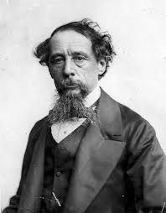
Charles dickens
The most popular and the most important figure in Victorian literature
A Christmas carol
David copperfield
Oliver twist
Great expectations
A tale of two cities

Slide 10
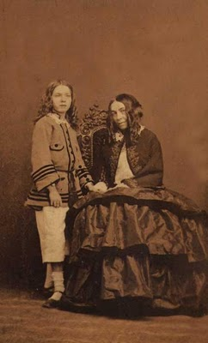
Elizabeth barrett browning
One of the most famous poets of her day
Wrote on intellectual, religious, and political matters
Father forbid her to marry, but she eloped with Robert browning
Had a son (Pen) when she was 43
Died at 55

Slide 11
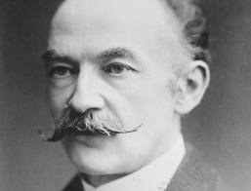
Thomas hardy
Novelist, poet, architect
Believed the world was governed by nature’s laws and indifferent to humans
Bleakness, pessimism
Anticlimax – when something trivial or comical happens at the point in a story when one expects something important or serious

Slide 12
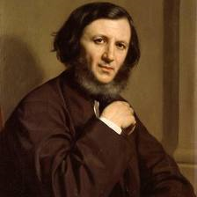
Robert browning
“poet of men’s souls”
Fan of Elizabeth barrett browning; began their correspondence; received recognition for his own poems after she died
“only by acting boldly can one wrest what is good from an imperfect world”
Challenged readers to discover what is virtuous and how love nourished and kills
Dramatic monologue – poems in which a speaker who is not the poet addresses a listener who does not speak

Slide 13
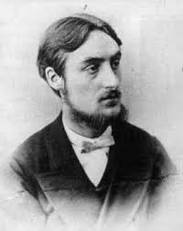
Gerard Manley Hopkins
Ordained a Jesuit priest
Served in parishes in the poorest sections of England and Scotland
Died of typhoid fever at 44 years old
Pied – 2 or more colors in blotches

Slide 14
“Pied Beauty”
GLORY be to God for dappled things—
For skies of couple-colour as a brinded cow;
For rose-moles all in stipple upon trout that swim;
Fresh-firecoal chestnut-falls; finches’ wings;
Landscape plotted and pieced—fold, fallow, and plough; 5
And áll trádes, their gear and tackle and trim.
All things counter, original, spare, strange;
Whatever is fickle, freckled (who knows how?)
With swift, slow; sweet, sour; adazzle, dim;
He fathers-forth whose beauty is past change: 10
Praise him

Slide 15
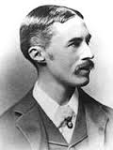
a. e. housman
Believed poetry was all about feelings; “self-indulgent bellyaching”
“the test of poetry is not what is said, but how it is said.”

Slide 16
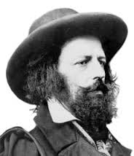
Alfred, lord tennyson
Never considered a career other than poetry
Composed a 6,000 line epic poem by age 12
Poet laureate and baron

Slide 17
Vocabulary
Waning
Prosper
Countenance
Dowry
Eludes
Sullen
Obscured
Gaunt
Rue
Smudge

